Slide 1
CSA0404-Operating System(slot-c)
PAGE REPLACEMENT ALGORITHM
Guided By,
Dr. G. Mary Valantina
(Course Faculty)
SSE,SIMATS.
Project By,
P. Sivanvitha(192224041)
T. Nikitha(192224053)
T. Naga Chandu(192211843)
SSE,SIMATS

Slide 2
ABSTRACT:
Page replacement algorithms are crucial components of virtual memory management systems, aiming to optimize memory utilization and minimize page faults. This paper presents a comparative study of three fundamental page replacement algorithms: First-In-First-Out (FIFO), Least Recently Used (LRU), and Optimal. FIFO operates on the principle of evicting the oldest page in memory when a new page needs to be brought in. LRU, on the other hand, evicts the page that has not been accessed for the longest period. Optimal, often considered the theoretical ideal, selects the page that will not be accessed for the longest time in the future The study evaluates these algorithms across various metrics including page fault rates, computational complexity, and adaptability to different workload scenarios. Simulations are conducted to analyze the algorithm behavior under diverse conditions, ranging from sequential access patterns to irregular access distributions. Furthermore, the paper explores practical considerations such as implementation overhead and memory footprint associated with each algorithm. Insights gained from the study can aid system designers and developers in selecting the most appropriate page replacement strategy based on system requirements and constraints. By shedding light on the strengths and limitations of FIFO, LRU, and Optimal algorithms, this study contributes to the ongoing discourse on memory management optimization and provides valuable guidance for improving system performance in virtual memory environments.

Slide 3
INTRODUCTION:
Page replacement algorithms are critical components of memory management in computer operating systems, particularly in systems that utilize virtual memory. These algorithms are responsible for selecting which page to evict from memory when a new page needs to be loaded in. Among the various page replacement algorithms, three commonly used ones are First-In-First-Out (FIFO), Least Recently Used (LRU), and Optimal.
FIFO (First-In-First-Out): FIFO is one of the simplest page replacement algorithms. It operates on the principle of a queue: the page that has been in memory the longest is the one selected for replacement. When a page needs to be replaced, the oldest page in memory, i.e., the one that entered first, is removed.
LRU (Least Recently Used): LRU is based on the idea that the page that has not been accessed for the longest period of time is the one to replace. It requires keeping track of the time when each page was last accessed.
Optimal: The Optimal algorithm, also known as the "Belady’s Optimal Algorithm," serves as a theoretical benchmark for comparing other page replacement algorithms. It operates by selecting the page that will not be used for the longest period of time in the future.

Slide 4
LITERATURE REVIEW:
Numerous studies have been conducted to investigate the performance of page replacement algorithms in virtual memory systems.
Early research focused on simple algorithms such as FIFO and LRU, examining their theoretical properties and practical implications.
Subsequent work introduced more sophisticated algorithms and proposed optimizations to address the limitations of existing approaches. Comparative studies have been conducted to benchmark the performance of different algorithms using various metrics, including page fault rate, cache hit rate, and system overhead.
Additionally, researchers have explored the impact of workload characteristics on the effectiveness of page replacement strategies, leading to the development of adaptive and hybrid approaches.

Slide 5
IMPLEMENTATION:
1.FIRST-IN-FIRST-OUT(FIFO):
FIFO is one of the simplest page replacement algorithms. It operates on the principle of evicting the oldest page in memory when a new page needs to be brought in. Here's a step-by-step explanation of how FIFO works:
Initialization: Maintain a queue (or array) of fixed size representing the frames in memory. Initially, all frames are empty.
Page Fault Handling:
When a page fault occurs (i.e., a requested page is not in memory):
If there is free space in memory (i.e., the number of frames used is less than the total number of frames available
If memory is full:
Select the page that was brought into memory first (i.e., the oldest page) for eviction.
Remove the oldest page from the front of the queue.
Bring the new page into memory and place it at the end of the queue.
Counting Page Faults: Increment a counter each time a page fault occurs.
FIFO's simplicity comes from its straightforward eviction strategy: it always evicts the page that has been in memory the longest.This algorithm is easy to implement and has a low overhead, making it suitable for systems with limited computational resources.

Slide 6
2.LEAST RECENTLY USED(LRU):
LRU operates on the principle of evicting the page that has not been accessed for the longest time. Here's how it works:
Initialization: Maintain a data structure (such as a linked list, queue) to keep track of the order in which pages are accessed. Initially, all frames are empty.
Page Access Handling:
When a page is accessed:
If the page is already in memory:
-Update its position in the data structure to reflect that it was the most recently used page.
3.If the page is not in memory (i.e., a page fault occurs):
-Bring the requested page into memory and place it at the front of the data structure to indicate that it's the most recently used page.
-If memory is full, evict the page at the end of the data structure (the least recently used page).
Counting Page Faults: Increment a counter each time a page fault occurs.
The key idea behind LRU is to approximate the optimal page replacement strategy by assuming that the least recently used pages are less likely to be used in the near future.

Slide 7
3.OPTIMAL:
Initialization: Maintain a data structure (such as a hashmap or array) to keep track of future page accesses.
Predicting Future Page Accesses:
When a page is brought into memory, analyze the remaining reference string (sequence of page accesses) to predict when the page will be accessed next.
Select the page that will not be accessed for the longest time in the future for eviction.
Page Fault Handling:
When a page fault occurs (i.e., a requested page is not in memory)
If there is free space in memory, simply bring the requested page into memory.
If memory is full:
Predict future page accesses for each page in memory based on the remaining reference string.
Evict the page that will not be accessed for the longest time in the future according to the predictions.
Bring the new page into memory.
Counting Page Faults: Increment a counter each time a page fault occurs.
Implementing the Optimal algorithm involves simulating the future by scanning the remaining reference string from the current position to predict future page accesses.

Slide 8
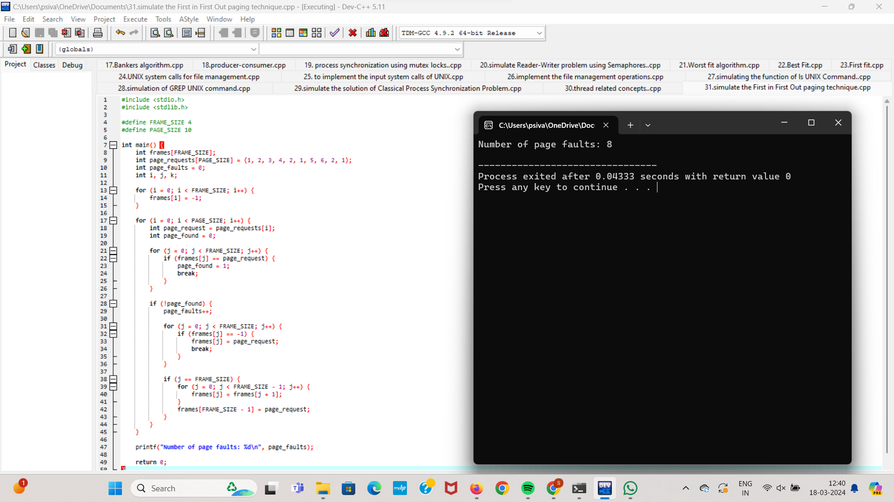
OUTPUT FOR FIFO CODE:

Slide 9
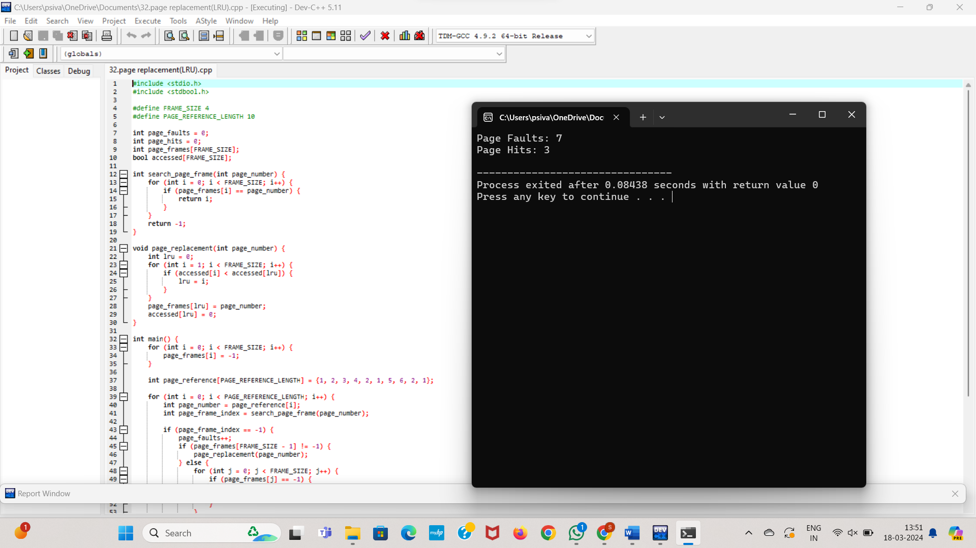
OUTPUT FOR LRU CODE:

Slide 10
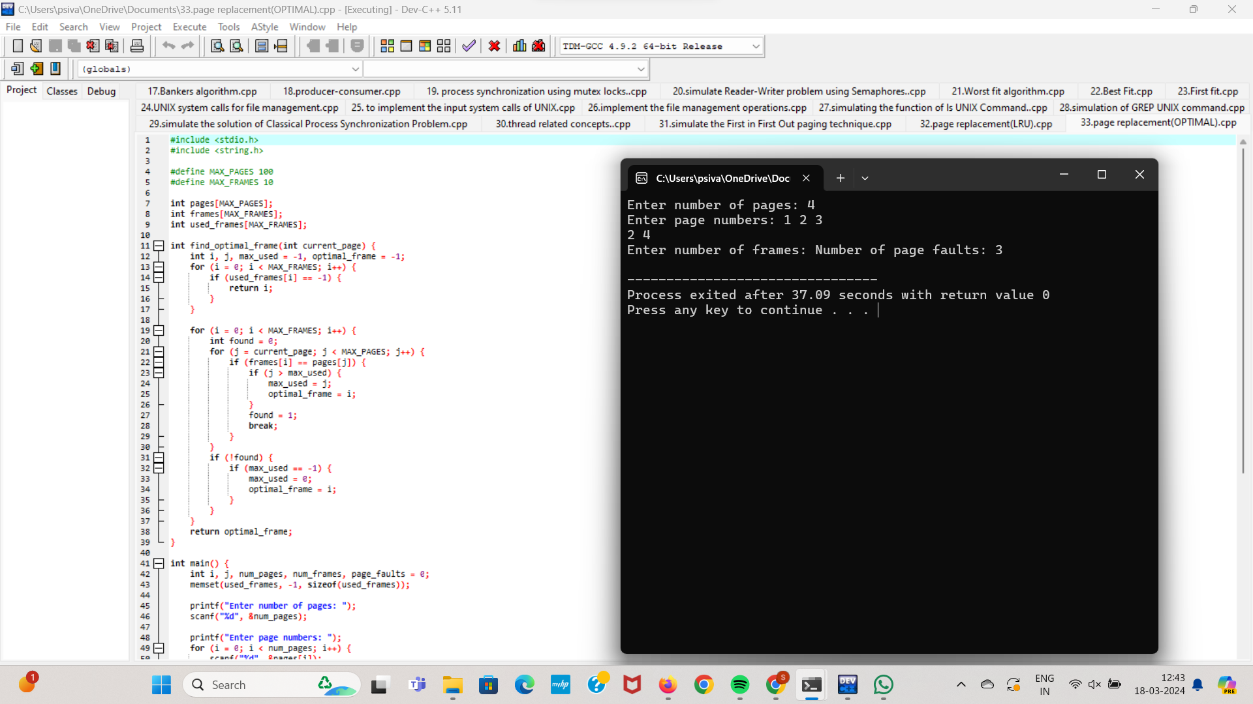
OUTPUT FOR OPTIMAL CODE:

Slide 11
FIRST-IN-FIRST-OUT(FIFO)
ADVANTAGES:
LIMITATIONS:
Simple to implement.
Low computational overhead.
Fairly predictable behavior.
Can suffer from the "Belady's Anomaly,“
where increasing the number of frames
can lead to more page faults.
LEAST RECENTLY USED
ADVANTAGES:
LIMITATIONS:
Attempts to approximate the optimal page replacement strategy by evicting the least recently used pages.
Often performs better than FIFO in practice.
May require more memory and computational overhead to maintain the access order of pages.
Can be more complex to implement compared to FIFO.
OPTIMAL
ADVANTAGE:
LIMITATIONS:
Provides a benchmark for evaluating the performance of other algorithms.
Requires knowledge of future page accesses, which is typically not available in practice.
Not feasible for practical implementations due to its reliance on future information.

Slide 12
CONCLUSION:
In conclusion, page replacement algorithms are fundamental to memory management in operating systems, determining the eviction and replacement of pages in memory. Each algorithm—FIFO, LRU, and Optimal—offers distinct advantages and limitations. FIFO, being the simplest, operates on a first-in-first-out basis but may suffer from the Belady's Anomaly, leading to increased page faults with more frames. LRU aims to approximate the optimal strategy by evicting the least recently used pages and generally outperforms FIFO, though it requires additional data structures and computational overhead. Optimal represents the theoretical best-case scenario but is impractical due to its reliance on future information. In practice, the choice of algorithm depends on system constraints and performance requirements, often involving a trade-off between simplicity, computational overhead, and performance.
Real-world implementations may combine strategies or employ variations of these algorithms to achieve optimal memory management and system performance. Understanding these algorithms' strengths, weaknesses, and practical implications is essential for designing efficient memory management systems in operating environments.

Slide 13
REFERENCES:
Bell, John. "Operating Systems Course Notes: Virtual Memory". University of Illinois at Chicago College of Engineering. Archived from the original on 23 September 2018. Retrieved 21 July 2017.
Torrez, Paul; et al. "CS111 Lecture 11 notes". UCLA Computer Science Department. Archived from the original on 9 January 2009.
Bahn, Hyokyung; Noh, Sam H. (12–14 February 2003). Characterization of Web reference behavior revisited: Evidence for Dichotomized Cache management. International Conference on Information Networking 2003. Jeju, South Korea: Springer-Verlag. pp. 1018–1027. doi:10.1007/978-3-540-45235-5_100. ISBN 978-3-540-40827-7.
Tanenbaum, Andrew S. (2001). Modern Operating Systems (2nd ed.). Upper Saddle River, NJ, USA: Prentice-Hall. p. 218 (4.4.5). ISBN 978-0-13-031358-4. LCCN 00051666. OCLC 45284637. OL 24214243M.

